Slide 1
PaaS Hosting and Performance on Cloud foundry, Heroku and Google Cloud
A COMPARATIVE STUDY BY:
Vishvesh Kadam (18210026)
Paritosh gupta (18210686)
Shashank Ravishankar (18210902)

Slide 2
OBJECTIVE
Build Web Application
Deployment on Different Cloud Platforms
Compare the four on following points:
Ease of Deployment
User Friendly Environment
Statistics of Deployed App Performance
Compare and Contrast Results

Slide 3
TECHNOLOGIES USED
HTML5
CSS
JAVASCRIPT
PHP

Slide 4
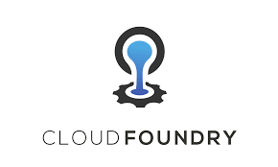
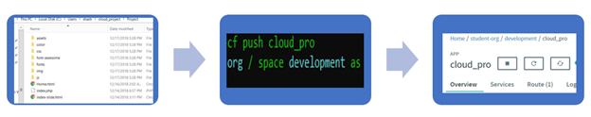
Cloud Foundry
Pivotal Cloud Foundry
Ease of Use: Easy
Deployment Details:
Cloud Foundry is an open platform as a service (PaaS)
that provides a choice of clouds, developer frameworks, and application services.
Cloud Foundry makes it faster and easier to build, test, deploy,
and scale applications.

Slide 5
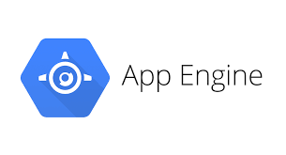
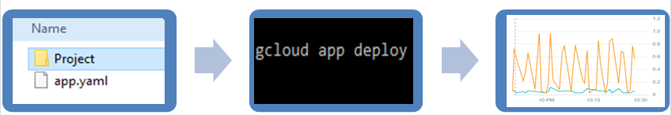
Google Cloud
Google Cloud App Engine
Deployment Details
Hurdles Faced
Failed to load website using drag and drop
method. So deployed using google SDK.
Ease of Use: Relatively easy deployment
Google has a reputation for highly reliable, high performance infrastructure. With App Engine you can take advantage of the 10 years of knowledge Google has in running massively scalable, performance driven systems. App Engine applications are easy to build, easy to maintain, and easy to scale as your traffic and data storage needs grow.

Slide 6
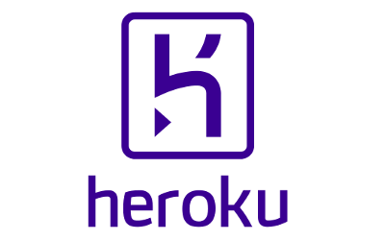
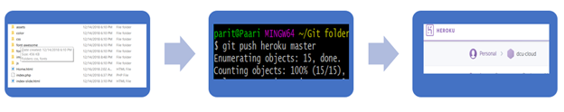
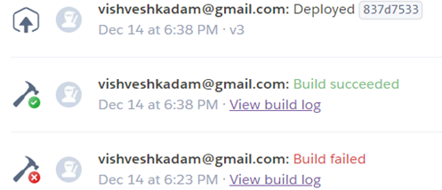
Heroku Implementation
Heroku CLI & Git Client
Deployment Details
Hurdles Faced
Heroku is a cloud application platform – a new way of building and deploying web apps. Heroku lets app developers spend 100% of their time on their application code, not managing servers, deployment, ongoing operations, or scaling.

Slide 7

WEB APPLICATION DEMO

Slide 8
Application HTTP Response Time
Google Cloud
Cloud Foundry
Heroku
Data gathered from- https://dotcom-monitor.com

Slide 9
App Load Time – Browser Compatibility
Google Cloud
Heroku
Cloud Foundry
Data gathered from- https://dotcom-monitor.com

Slide 10
Comparison and Contrast : Heroku vs. Google App Engine vs. Cloud Foundry
Parameters | Heruko | Google App engine | Cloud Foundary
1. Java Support | Poor | Basic | Best
2. Deployment | Easy | Easy | Easy
3. OS supported | Windows, Web-based ,Mac and Android | Windows, Web-based and Mac | Strong
4. Self-service monitoring | Leading | Strong | Strong
5. Load balancing | Leading | Strong | Leading
6. Storage/ Backup | Basic | Strong | Basic
PROS | Offers standard SQL. Relatively painless deployment. Simpler pricing model. | Access to the rest of Google services. Running asynchronous tasks much easier than Heroku. Runs on Google’s own cloud infrastructure. | Perfectly aligned with springboot Application health management Free service discovery (Eureka) Free distributed tracing (zipkin)
CONS | Not as large as Google. Hosted on AWS which suffers major outages | Platform tie-in, lack of flexibility. No standard SQL DB. | Does not support stateful containers Supports showing logs, but does not persist the logs anywhere. This makes relying on Cloud Foundry's logs very unreliable. The logs have to be persisted using other third party tools like Elk and Kibana.

Slide 11
Code links
Deployed PaaS Application Address:
Google Cloud –https://cloud-dcu-ca674.appspot.com/
Cloud Foundry – https://cloudpro.cfapps.io/
Heroku CLI -https://herukodcu.herokuapp.com/

Slide 12
WORK DISTRIBUTION:
Cloud Foundary Deployment - Shashank
Heroku Deployment – Paritosh
Google App Engine deployment – Vishvesh
App development, Performance testing and comparison study – done together.

Slide 13
THANK YOU

